Slide 1
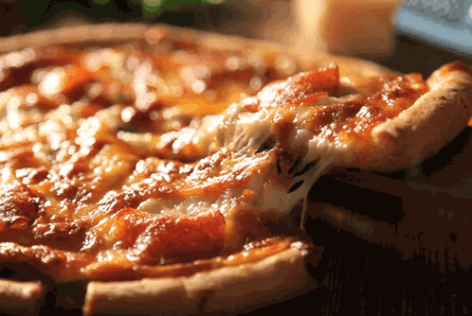
Pizza SQL Mini Project

Slide 2
Phase 1: Foundation & InspectionPhase
2.List all unique pizza categories (DISTINCT)
SQL:
SELECT DISTINCT category
FROM pizza_types;
1.Install IDC_Pizza.dump as IDC_Pizza server

Slide 3
3.Display pizza_type_id, name, and ingredients, replacing NULL ingredients with "Missing Data". Show first 5 rows.
SQL:
SELECT pizza_type_id,
name,
COALESCE(ingredients,'Missing Data’)
FROM pizza_types LIMIT 5;
4.Check for pizzas missing a price (IS NULL).
IS NULL checks empty price fields.
Useful for data cleaning.
SQL:
SELECT pizza_id, size,
price
FROM pizzas
WHERE price IS NULL;

Slide 4
Phase 2: Filtering & Exploration
1.Orders placed on '2015-01-01' (SELECT + WHERE).
Filters records using WHERE.
SQL:
SELECT order_id,
date,
time
FROM orders
WHERE date='2015-01-01';
2.List pizzas with price descending.
SELECT
pizza_id, size,
price
FROM pizzas
ORDER BY price DESC;

Slide 5
3.Pizzas sold in sizes 'L' or 'XL’.
SELECT size
FROM pizzas
WHERE size = 'L’ or size='XL';
4.Pizzas priced between $15.00 and $17.00.
SELECT
pizza_id, size, price
FROM pizzas
WHERE price BETWEEN 15.00 and 17.00;

Slide 6
5.Pizzas with "Chicken" in the name.
SELECT category AS name
FROM pizza_types
WHERE category ='Chicken';
6.Orders on '2015-02-15' or placed after 8 PM.
SELECT date,time
FROM orders
WHERE date = '2015-02-15’ OR time > '20:00:00';

Slide 7
Phase 3: Sales Performance
1.Total quantity of pizzas sold (SUM).
SELECT SUM(quantity) AS Total_quantity
FROM order_details;
2.Average pizza price (AVG).
SELECT AVG(price) AS avg_price
FROM pizzas;

Slide 8
3.Total order value per order (JOIN, SUM, GROUP BY).
JOIN + GROUP BY gives per-order totals.
SQL:
SELECT od.order_id,
SUM(od.quantity)
FROM order_details od
JOIN pizzas p ON od.pizza_id=p.pizza_id
GROUP BY od.order_id;
4.Total quantity sold per pizza category (JOIN, GROUP BY).
JOIN links tables for category totals.
SQL:
SELECT pt.category AS pizza_category,
SUM(od.quantity) AS total_quantityFROM pizza_types pt
JOIN pizzas p ON pt.pizza_type_id = p.pizza_type_id
JOIN order_details od ON p.pizza_id = od.pizza_id
GROUP BY pizza_category;

Slide 9
5.Categories with more than 5,000 pizzas sold (HAVING)
HAVING filters grouped data (>5000 units).
SQL:
SELECT pt.category AS pizza_category,
SUM(od.quantity) AS total_quantity
FROM pizza_types pt
JOIN pizzas p ON pt.pizza_type_id = p.pizza_type_id
JOIN order_details od ON p.pizza_id = od.pizza_id
GROUP BY pt.category
HAVING SUM(od.quantity) > 5000;

Slide 10
6.Pizzas never ordered (LEFT/RIGHT JOIN)
LEFT JOIN + NULL finds pizzas with no orders.
SQL:
SELECT p.pizza_id, p.pizza_type_id,
p.size, pt.name, pt.category, od.order_details_id
FROM pizzas p
LEFT JOIN pizza_types pt ON p.pizza_type_id = pt.pizza_type_id
LEFT JOIN order_details od ON p.pizza_id = od.pizza_id
WHERE od.order_details_id IS NULL;

Slide 11
7.Price differences between different sizes of the same pizza (SELF JOIN).Difference (SELF JOIN)
Self join compares size-based pricing.
SQL:
SELECT p1.pizza_type_id,
p1.size AS p1_size, p1.price AS p1_price,
p2.size AS p2_size, p2.price AS p2_price,
(p1.price - p2.price) AS difference_price
FROM pizzas p1
JOIN pizzas p2 ON p1.pizza_type_id = p2.pizza_type_id
ORDER BY p1.pizza_type_id,p1.size ;

